Slide 1
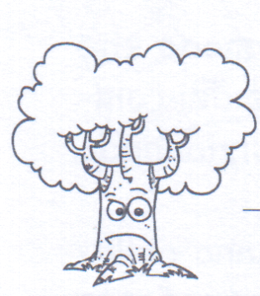
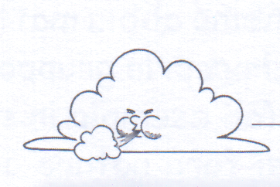
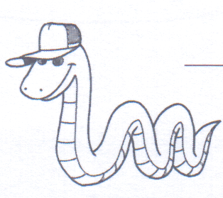
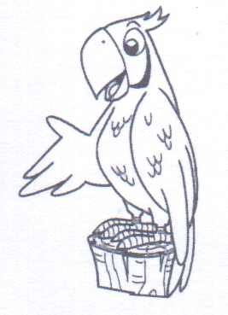
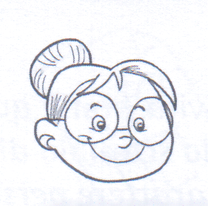
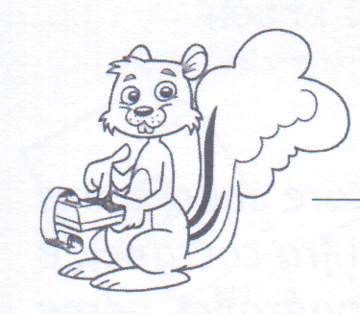
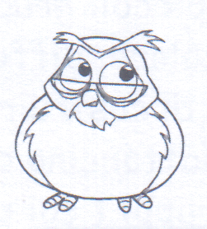
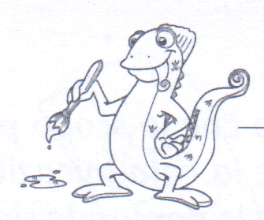
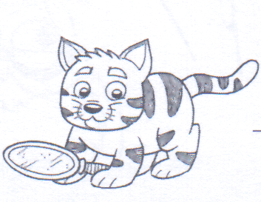
Serpente Giringiò
Intelligenza cinestetica
Albero Nonò
Intelligenza naturalistica
Pappagallo Lingualesta
Intelligenza linguistica
Vento
Intelligenza musicale
…ancora
9 volte
Intelligenti
Scoiattolo Matemì
Intelligenza matematica
Maestra Carlotta
Intelligenza Interpersonale
Camaleonte Pennellone
Intelligenza visivo-spaziale
Gufo Lampadina
Intelligenza esistenziale
Scuola dell’Infanzia
IC Gambolò
a.S. 2012-2013
Gatto Sofficino
Intelligenza intrapersonale

Slide 2
Maestra Carlotta Interpersonale
_____________________________
______________________________
______________________________
______________________________
______________________________
Griglia di programmazione: compila con le attività da proporre
Lingualesta linguistica
_____________________________
______________________________
______________________________
______________________________
______________________________
Giringiò cinestetica
_____________________________
______________________________
______________________________
______________________________
______________________________
Lampadina esistenziale
_____________________________
______________________________
______________________________
______________________________
______________________________
Matemì matematica
_____________________________
______________________________
______________________________
______________________________
______________________________
Nonò naturalistica
_____________________________
______________________________
______________________________
______________________________
______________________________
Sofficino intrapersonale
_____________________________
______________________________
______________________________
______________________________
______________________________
Pennellone visivo-spaziale
_____________________________
______________________________
______________________________
______________________________
______________________________
Vento musicale
_____________________________
______________________________
______________________________
______________________________
______________________________
Elenca gli oggetti inseriti nella scatola: ______________________________________________
________________________________________________________________________________
________________________________________________________________________________
________________________________________________________________________________

Slide 3
Maestra Carlotta Interpersonale
_____________________________
______________________________
______________________________
______________________________
______________________________
Griglia di valutazione
Lingualesta linguistica
_____________________________
______________________________
______________________________
______________________________
______________________________
Giringiò cinestetica
_____________________________
______________________________
______________________________
______________________________
______________________________
Lampadina esistenziale
_____________________________
______________________________
______________________________
______________________________
______________________________
Matemì matematica
_____________________________
______________________________
______________________________
______________________________
______________________________
Nonò naturalistica
_____________________________
______________________________
______________________________
______________________________
______________________________
Sofficino intrapersonale
_____________________________
______________________________
______________________________
______________________________
______________________________
Pennellone visivo-spaziale
_____________________________
______________________________
______________________________
______________________________
______________________________
Vento musicale
_____________________________
______________________________
______________________________
______________________________
______________________________
NOTE: ____________________________________________________________________________________________________________
__________________________________________________________________________________________________________________
__________________________________________________________________________________________________________________
__________________________________________________________________________________________________________________

